Slide 1

Table and Chart Guidelines
Jordan Goldmeier

Slide 2
Charting Activities
Chart Layout
Tables Layout
Connecting the data
Data Visualization Process
Resources
Reference Materials

Slide 3
Chart Layout
Bold, left aligned chart title / lighter subtitle
Legend is out of the way and not on plot area
Axis matches significant digits of labels
No horizonal gridlines unless necessary
No horizonal gridlines unless necessary. Data labels provide specific information.
Plot area has light border / chart area has no border. White or clear backgrounds.
Bar and column charts have axes that always start at zero

Slide 4
Table Layout
Data inside table always matches alignment of its header.
Key value is always to the left of the table. Unless it’s an index column, should be left-aligned.
Key Value | Date | Categorical | Freeform Text | Numerical
Project 1 | 8/2/1999 | High | Blah blah blah | $5000.00
Project 2 | 10/23/1999 | Medium |  | $7000.00
Project 3 | 1/28/2000 | Low |  | $3000.20
Project 4 | 2/7/2000 | Medium | Canceled project | $500.00
Project 5 | 3/29/2000 | Medium | Great project! | $200.00
Project 6 | 6/18/2000 | Low |  | $5500.00
Project 7 | 7/16/2000 | Low |  | $9800.59
Project 8 | 10/10/2000 | High |  | $10,000.00
Project 9 | 11/11/2000 | Medium |  | $500.00
Free form text is left-aligned and wrapped.
If required, add a light horizontal line.
Only important data is highlighted
Left-align dates.
Categorical data is center-aligned.
Numerical data is always right-aligned and taken to most significant digit.

Slide 5
Connecting the data
What we present must always be the natural extension of the underlying problem.
For instance, it would not make sense to…
Use pie charts for time series data
Use discrete charts for connected data
Use 3d charts when the third dimension is just an embellishment

Slide 6
Data visualization process
Development
Refinement
Production
Be creative
Trial / Error
Break rules
Get as many “views” as you can
Present to leadership for initial review
Reduce charts down favorites
Solicit feedback
Identify main messages / themes
Focus on design & color
Identify audience match
Save improvements for next version

Slide 7
Pitfalls in Data Visualization Process
Too focused on data visualization rules early on
Putting perfection ahead of delivery
Creating the story before the chart
Not soliciting feedback
Not receiving feedback
Assuming there is only one way

Slide 8
Resources
Books
Storytelling with Data: A Data Visualization Guide for Business Professionals
The Functional Art: An Introduction to Information Graphics and Visualization
Information Dashboard Design
Dashboards for Excel
The Big Book of Dashboards: Visualizing Your Data Using Real-World Business Scenarios

Slide 9
Resources
Blogs
Chandoo - https://chandoo.org/wp/
Excel.tv – https://Excel.tv
New York Times “Upshot” - https://www.nytimes.com/section/upshot
Eager Eyes - https://eagereyes.org/
Information is beautiful.net - https://informationisbeautiful.net/

Slide 10
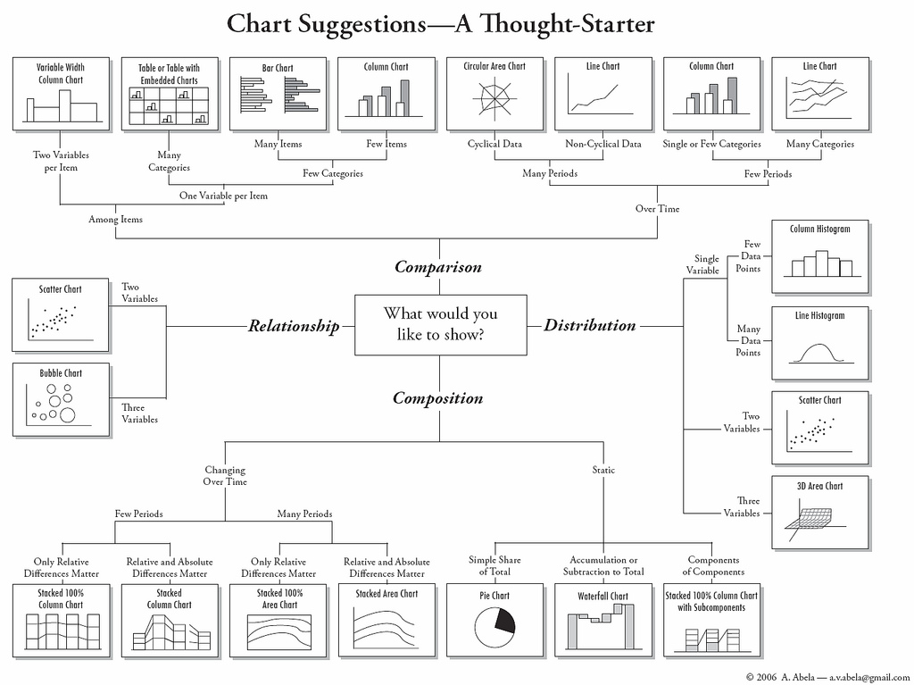
Reference Materials

Slide 11
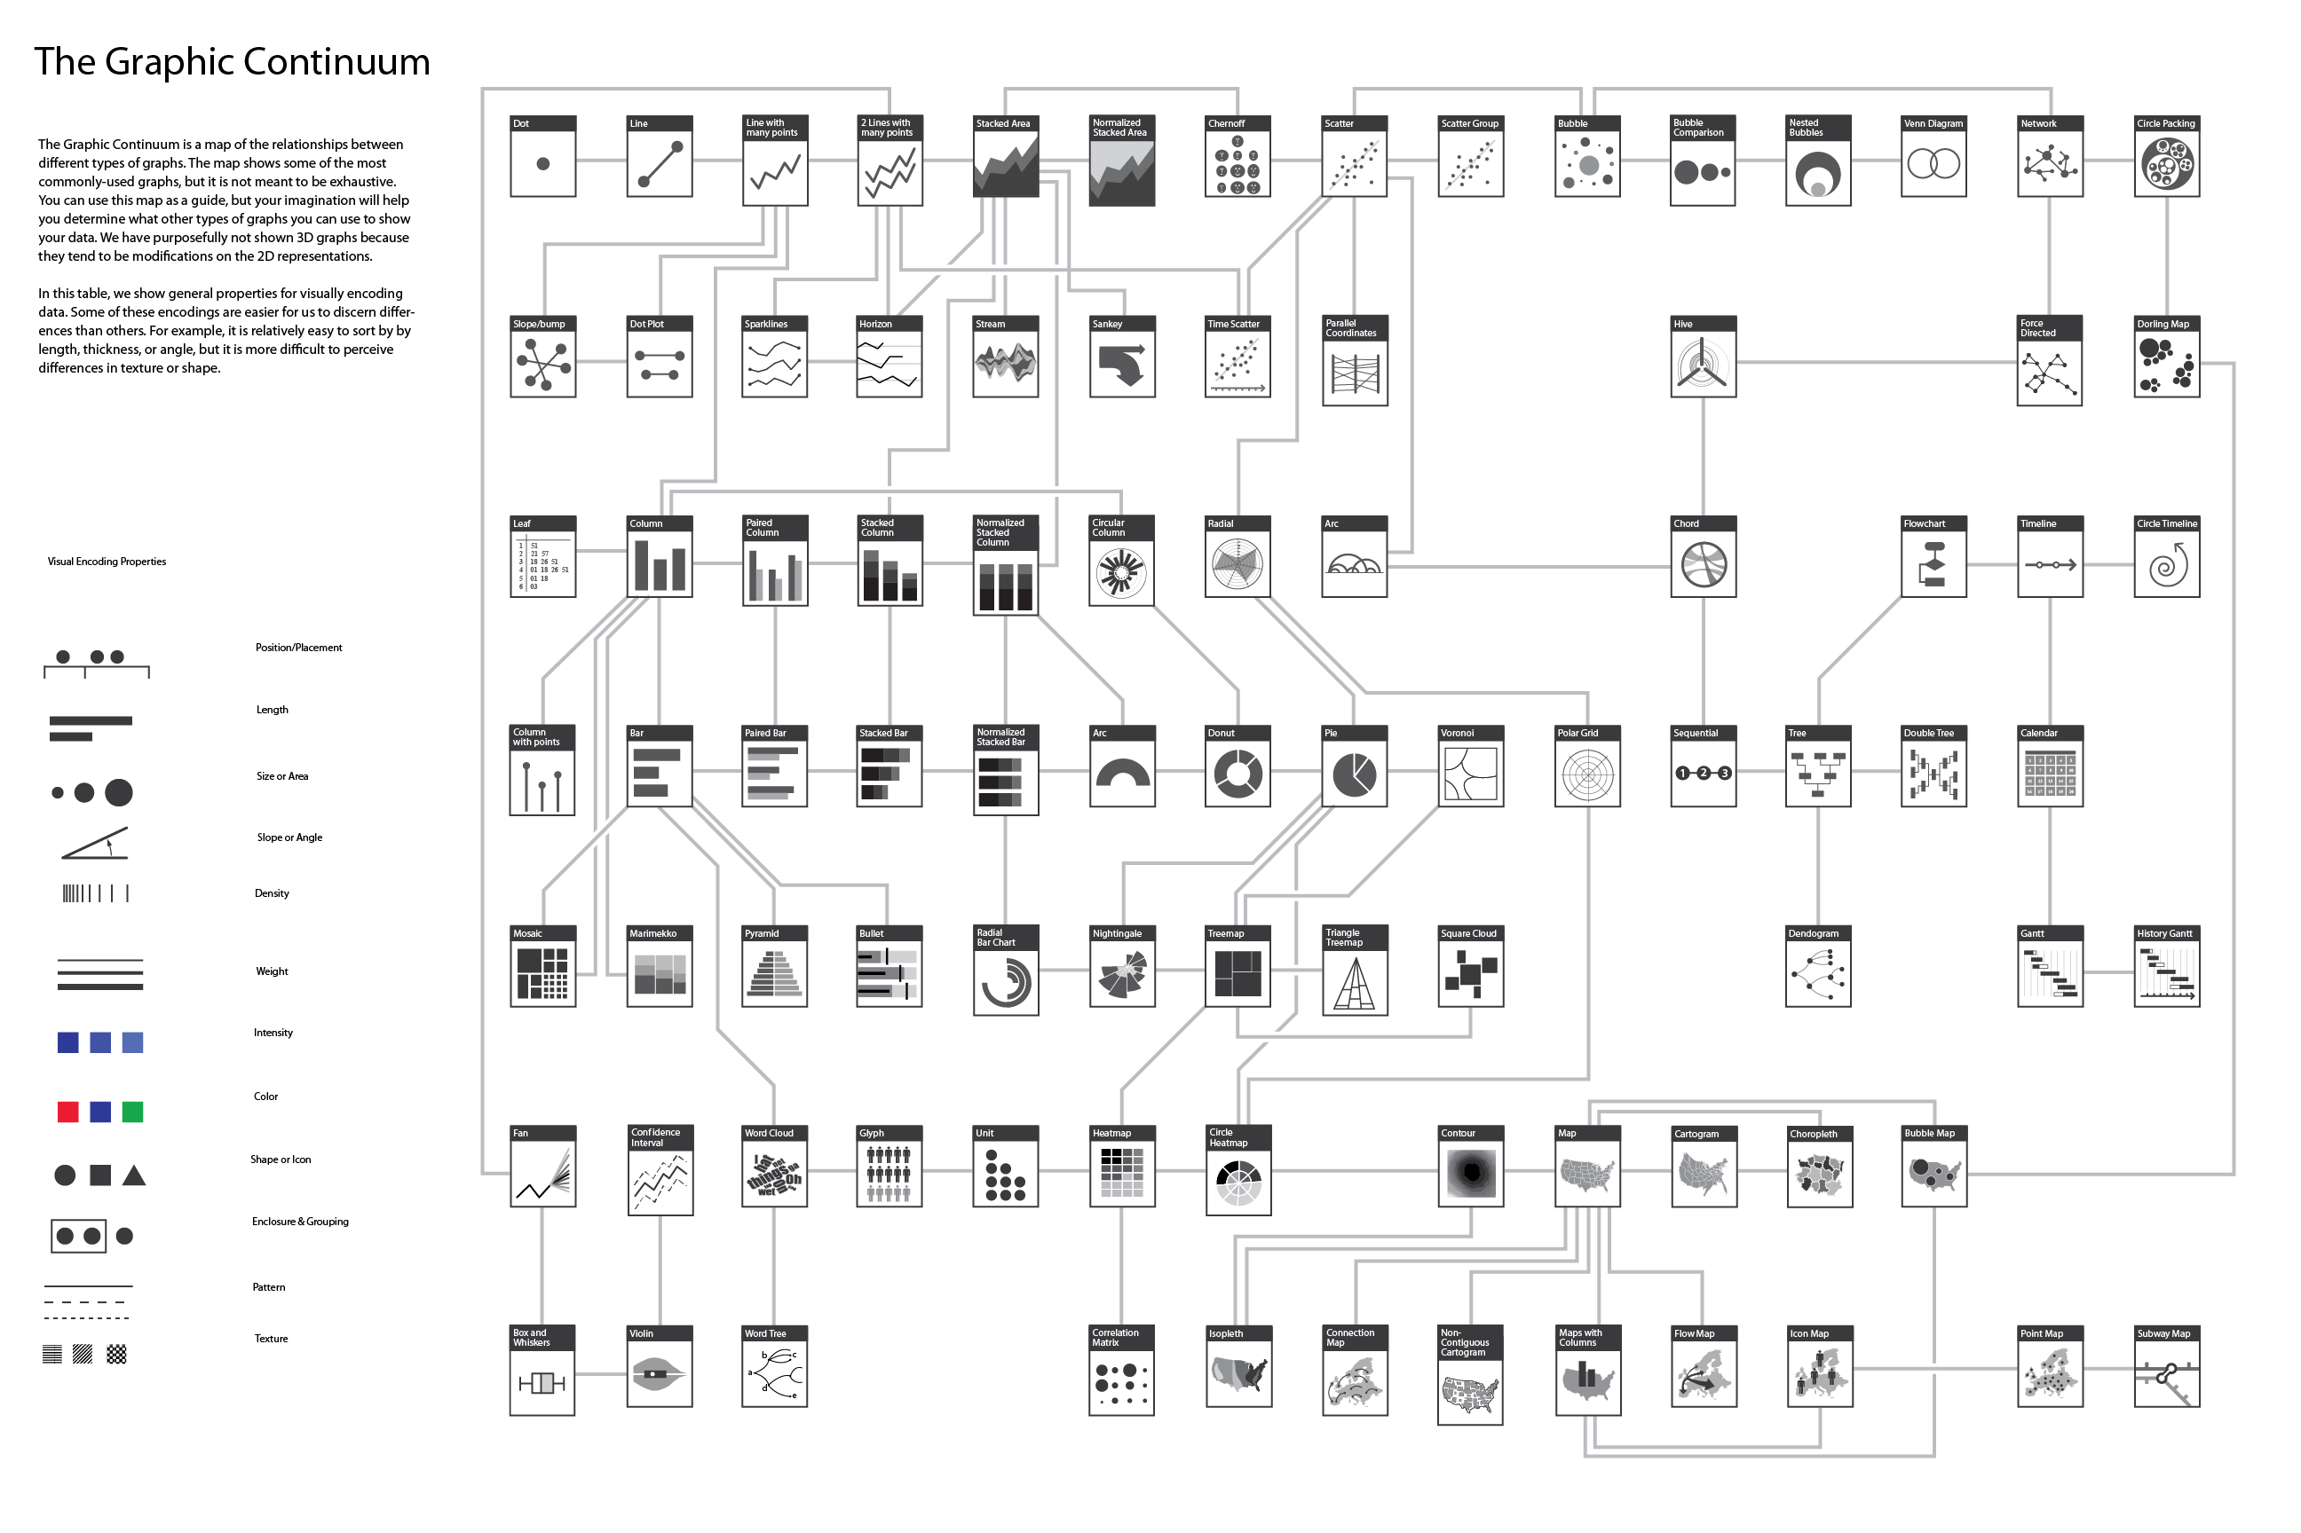
Reference Materials

